Slide 1
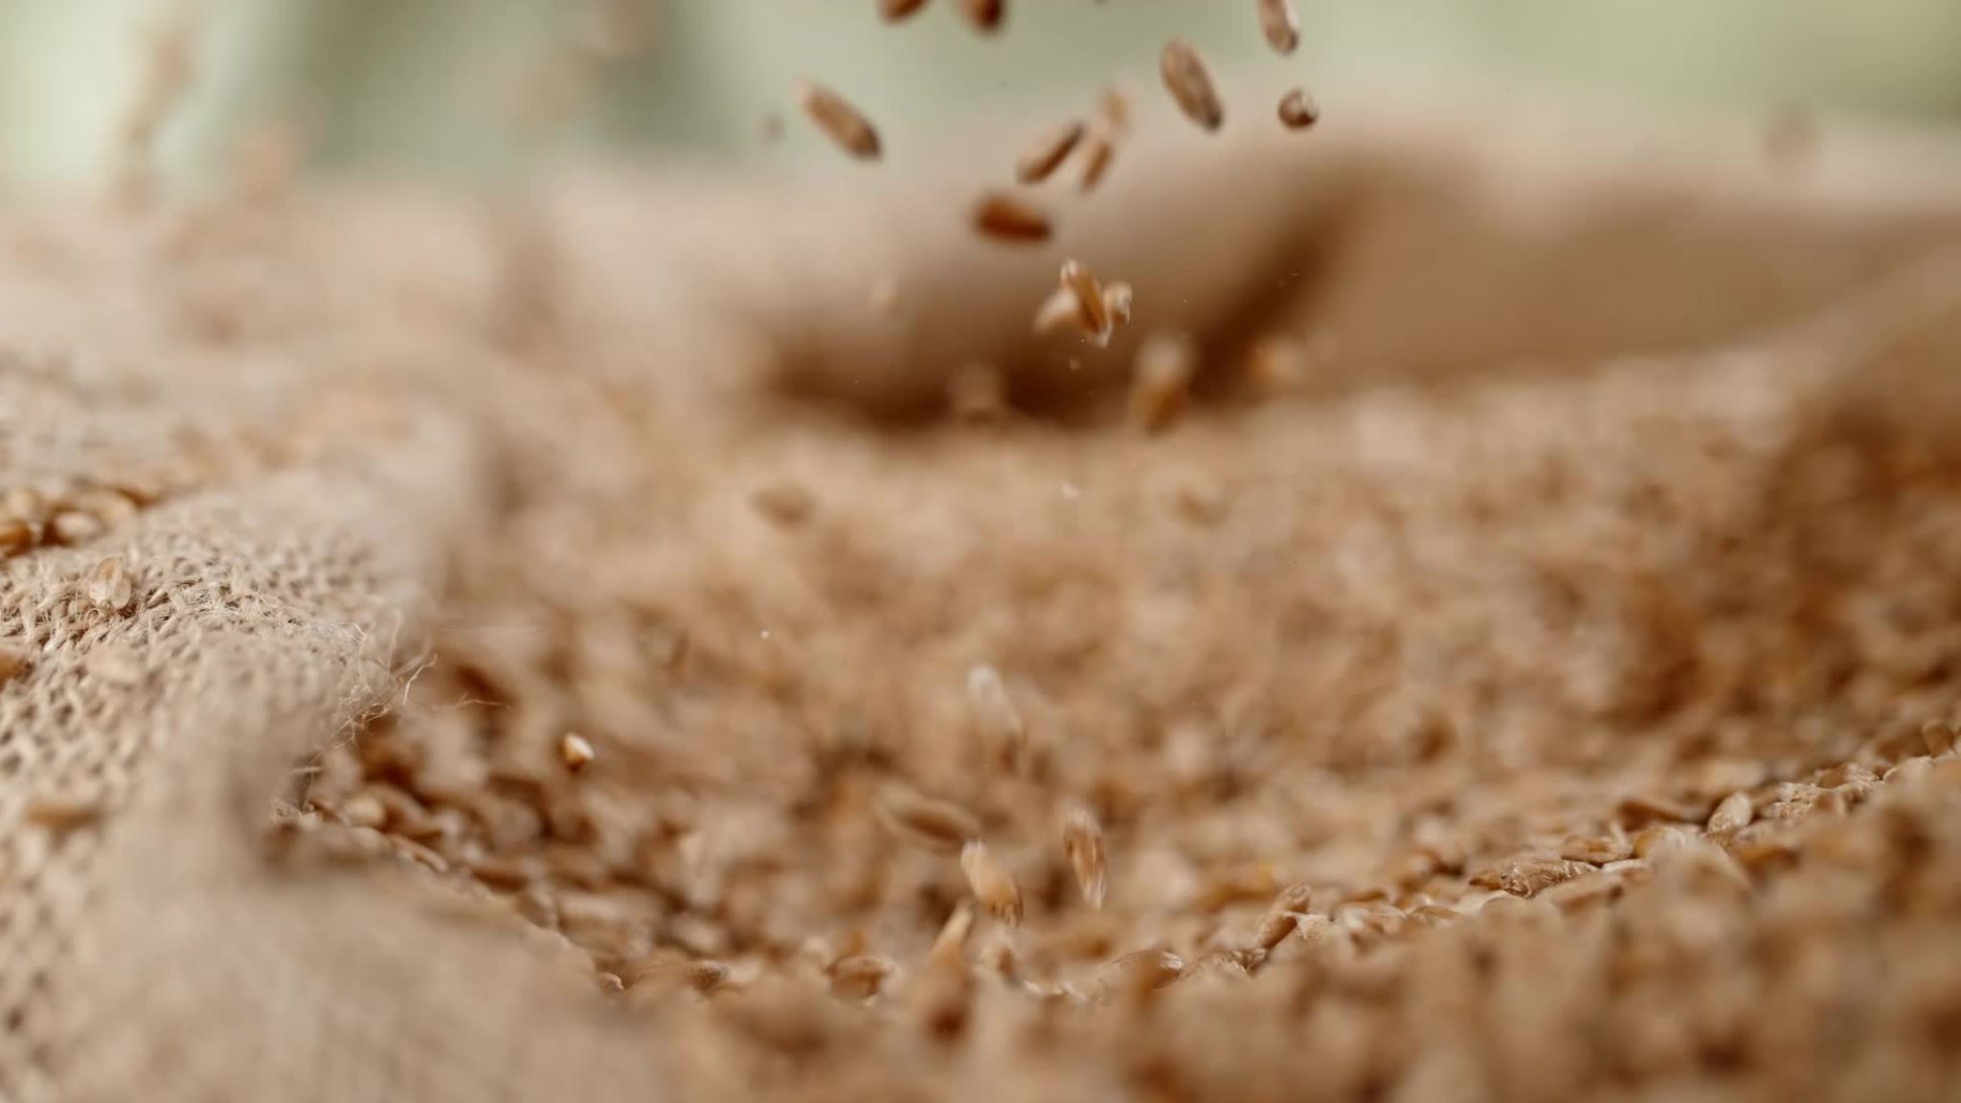
Crop Prediction
Using Rasp Berry Pi Pico

Slide 2

Problem Statement
Develop an integrated Crop Prediction System utilizing machine learning to enhance agricultural decision-making. The system aims to provide accurate and real-time predictions of suitable crops based on environmental factors, empowering farmers with data-driven insights for optimized crop planning and resource allocation.

Slide 3
Project Timeline: November 10 - December 10
10–16 Nov.
Week 1
Acquire necessary hardware components.
Set up and test soil sensors with Raspberry Pi Pico
17–23 Nov.
Week 2
Data Collection and Preprocessing:
Machine Learning Model Development:
Week 2
Data Collection and Preprocessing:
Machine Learning Model Development:
Week 3
Model Training and Evaluation:
Integration with Raspberry Pi Pico:
24 – Nov 30
24 – 30 Nov.
1-10 Dec
Week 4
User Interface Development (Optional):
Project Submission:

Slide 4

Components Required
Raspberry pi pico
An I2C HD44780 LCD screen display (16 x 2)
RS485 Auto Direction Module
RS-PH-NO1 -TR-7
Temperature and Humidity Sensor(DHT11)
Jumper Cable

Slide 5
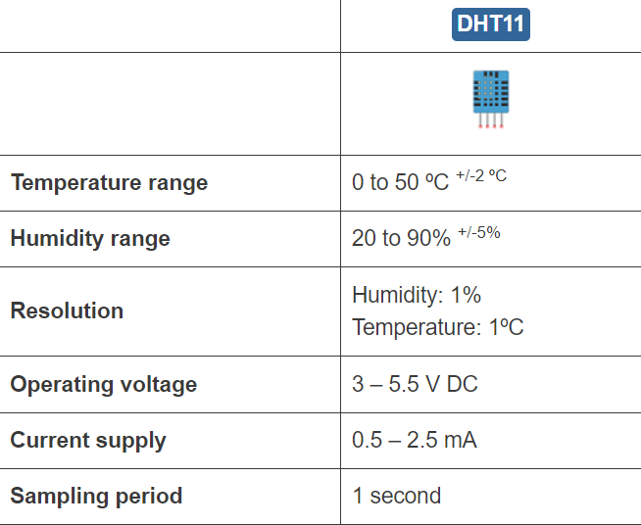
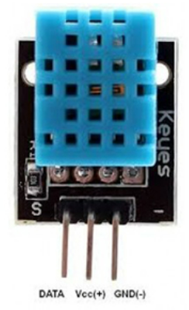
Temperature and Humidity Sensor
The DHT11 and DHT22 sensors are used to measure temperature and relative humidity. These sensors contain a chip that does analog to digital conversion and spit out a digital signal with the temperature and humidity.

Slide 6
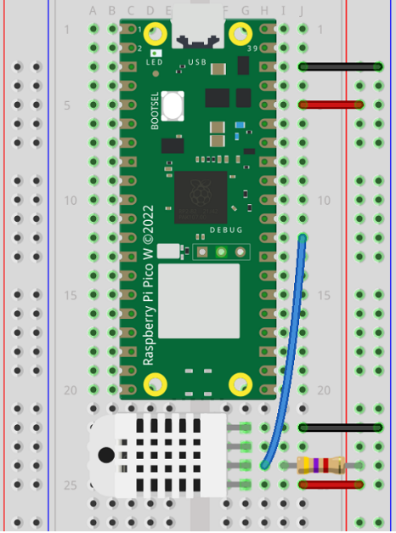
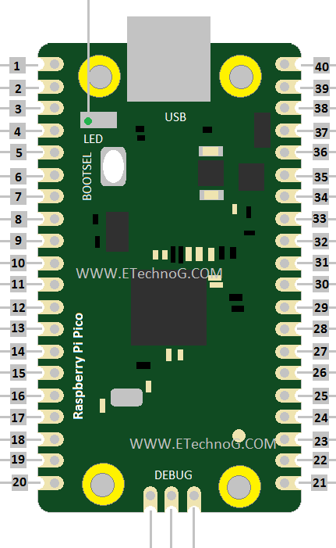
Connection Details

Slide 7
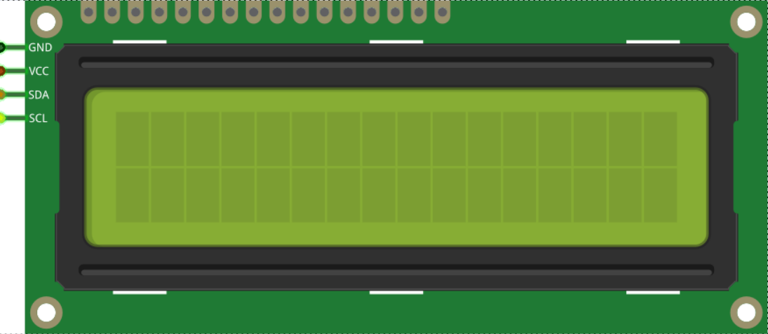
I2C HD44780 LCD screen display (16 x 2)
1. Connect the GND of the screen to any GND on the Pico (Black wire).
2. Connect VDD / VCC to VBUS on the Pico (Red wire). Warning this is a 5V pin.
3. Connect SDA to I2C0 SDA (GP0, Physical pin 1, Orange wire).
4. Connect SCK / SCL to I2C0 SCL (GP1, Physical pin 2, Yellow wire).

Slide 9
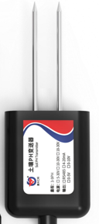
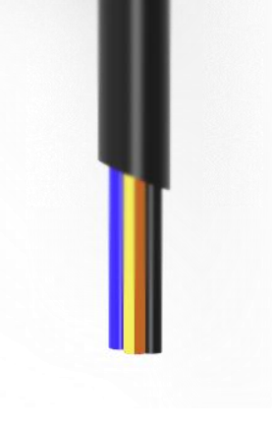
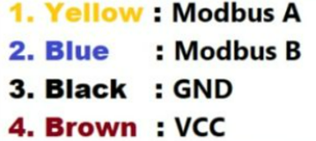
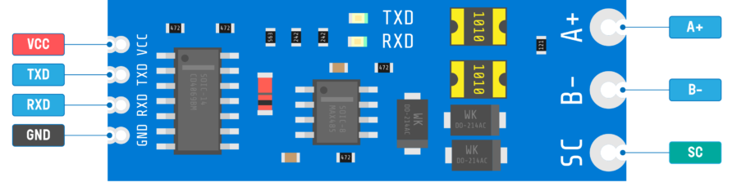
RS-PH-NO1 -TR-7
RS485 AUTO DIRECTION MODULE
RS-485 auto-direction modules are widely used in industrial automation systems for connecting sensors, actuators, and controllers.
A (Non-Inverted Signal): The "A" wire carries the non-inverted signal. When the logical level is high, the voltage on the "A" wire is higher than on the "B" wire.
B (Inverted Signal): The "B" wire carries the inverted signal. When the logical level is high, the voltage on the "B" wire is lower than on the "A" wire.
This is a Soil Ph Sensor that can measure the Soil Ph value from 3 to 9 with high accuracy up to ±0.3PH.
It has two nodes at the end ,which are dipped into the soil for ph level measurement

Slide 10
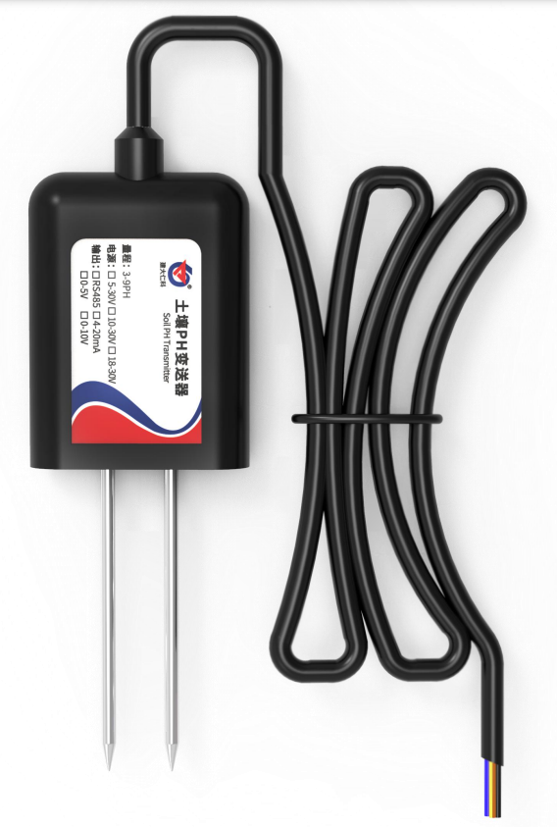
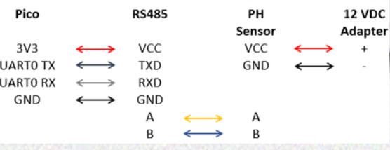

Slide 11
Final Block Diagram

Slide 12
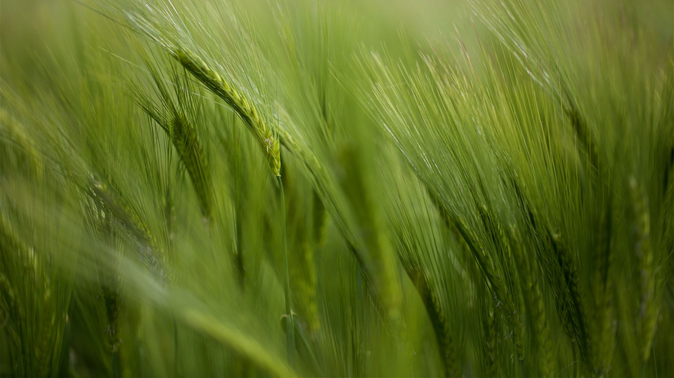
Machine Learning
DATASET USED: cpdata.csv (Taken From Kaggle)
This dataset captures environmental conditions associated with different crops, providing valuable insights for precision agriculture and crop management.
Columns:
Temperature: Recorded in degrees Celsius, indicating the ambient temperature.
Humidity: Measured as a percentage, representing the level of atmospheric moisture.
pH: Reflects the soil's acidity or alkalinity.
Rainfall: Denotes the amount of precipitation.
Label: Identifies the corresponding crop associated with the given environmental parameters. Ex:rice,watermelon

Slide 13
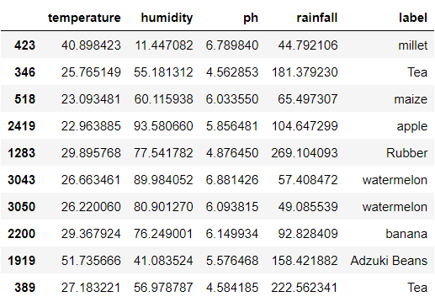
Sample data

Slide 14

Why cpdata?
While these mentioned columns are fundamental for predicting crop types, other columns in the dataset (if possible) can be explored during EDA and feature engineering. Additional features might provide valuable insights or improve the model's predictive performance. However, the mentioned columns are typically considered essential and form the core input features for a crop prediction model.
the selected columns encapsulate key environmental conditions and the target variable necessary for the model to learn patterns and make predictions about the most suitable crops under varying conditions in an agricultural setting.

Slide 15

Models Explored
Models Explored:
Decision Tree
Random Forest
Support Vector Machine
K-Nearest Neighbors
Chosen Model:Random Forest

Slide 16

Accuracy Test
Decision Tree Accuracy:
Decision Tree Accuracy: 92.15%
Random Forest Accuracy:
Random Forest Accuracy: 94.84%
Support Vector Machine Accuracy:
Support Vector Machine Accuracy: 61.94%
K-Nearest Neighbors Accuracy:
K-Nearest Neighbors Accuracy: 82.90%

Slide 17

Model Selection Considerations:
Ensemble Method: Random Forest is an ensemble method that combines multiple Decision Trees, reducing overfitting and improving generalization.
Accuracy: Achieved the highest accuracy (94.84%), making it a strong candidate for your dataset.
Computational Complexity: Random Forest can be more computationally intensive compared to a single Decision Tree.

Slide 18

How to run Machine Learning Models in Raspberry pi Pico?

Slide 19

Raspberry pi Pico:
a microcontroller with limited resources(i.e. Performace and memory)
The Raspberry Pi Pico, a compact microcontroller, presents unique challenges and opportunities for machine learning applications. This presentation explores the process of adapting and deploying ML models on this resource-constrained device.

Slide 20

ML Model To TensorFlow Lite
TensorFlow Lite: A streamlined version of TensorFlow for mobile and embedded devices(Low-Resource Devices)
"Benefits: Smaller model size, reduced latency, and lower power consumption."
"Conversion Process: Transforming Python ML models into a TensorFlow Lite format for microcontroller compatibility."

Slide 21

Preparing the Development Environment
"Thonny IDE: A user-friendly interface for MicroPython development on the Pico."
"Python Setup: Installing and configuring Python for use with Thonny and the Pico."

Slide 22

Steps Involved
Prepare Input Data:
Depending on what your model does, you might need to collect data from sensors or other sources. Write code to interface with these sensors and preprocess the data to the format expected by your model.
Load the Model and Code onto the Pico:
Use Thonny IDE or another tool to load the MicroPython script onto the Pico.
Load the trained Ml model into the pico
This script should include the logic for running your TensorFlow Lite model, along with any necessary model files or data
Predictions
From that input data we will predict the respective label
We will display the label using the lcd display

Slide 23

Conclusion
In conclusion, the Crop Prediction System harnesses the power of machine learning and edge computing on the Raspberry Pi Pico to revolutionize agricultural decision-making. By providing farmers with real-time predictions on optimal crop choices based on environmental factors, the system empowers them to make informed and resource-efficient decisions. The seamless integration with Raspberry Pi Pico ensures accessibility in the field, contributing to sustainability through precise resource allocation. The user-friendly interface enhances the technology's inclusivity, making it accessible to a diverse range of farmers. This project represents a significant step towards a future where advanced technologies drive efficiency and sustainability in agriculture, ultimately benefiting both farmers and the environment.

